Slide 1
Topic: 7 Steps of STLC Submitted By Tabammum Haque Pranty Submitted To Al Faysal Bin Asad SQA Engineer, Reve Systems

Slide 2
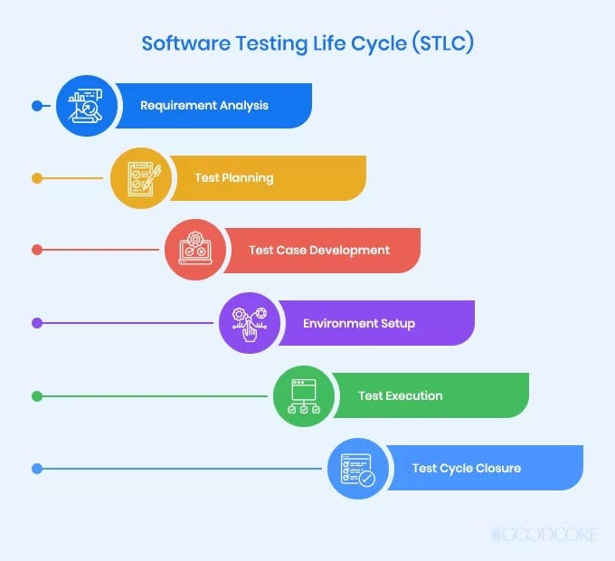
Contents
Introduction
Requirements Analysis
Test Planning
Test Case Development
Test Environment Setup
Test Execution
Defect Tracking and Reporting
Test Closure

Slide 3
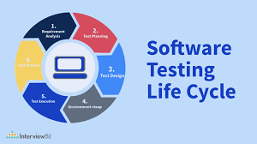
Introduction
STLC (Software Testing Life Cycle) is a process used to test software and ensure that quality standards are met.
It is a set of activities performed during the testing phase of software development.
STLC has seven phases such as: Requirements Analysis, Test Planning, Test Case Development, Test Environment Setup, Test Execution, Defect Tracking and Reporting and Test Closure.

Slide 4
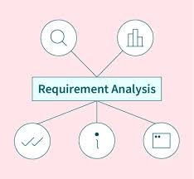
Requirements Analysis
Analyze the requirements from a testing perspective.
Identify testable requirements.
Prepare Requirement Traceability Matrix (RTM).

Slide 5
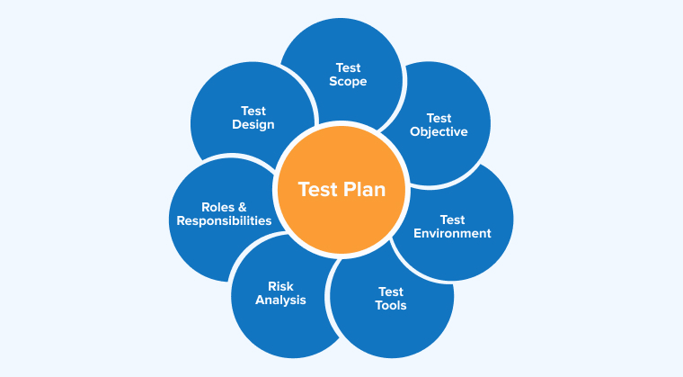
Test Planning
Define the scope, objectives and strategy for testing.
Estimate the effort and resources required.
Develop the test plan and assign roles.

Slide 6

Test Case Development
Design detailed test cases.
Create test data.
Review and validate the test cases.

Slide 7
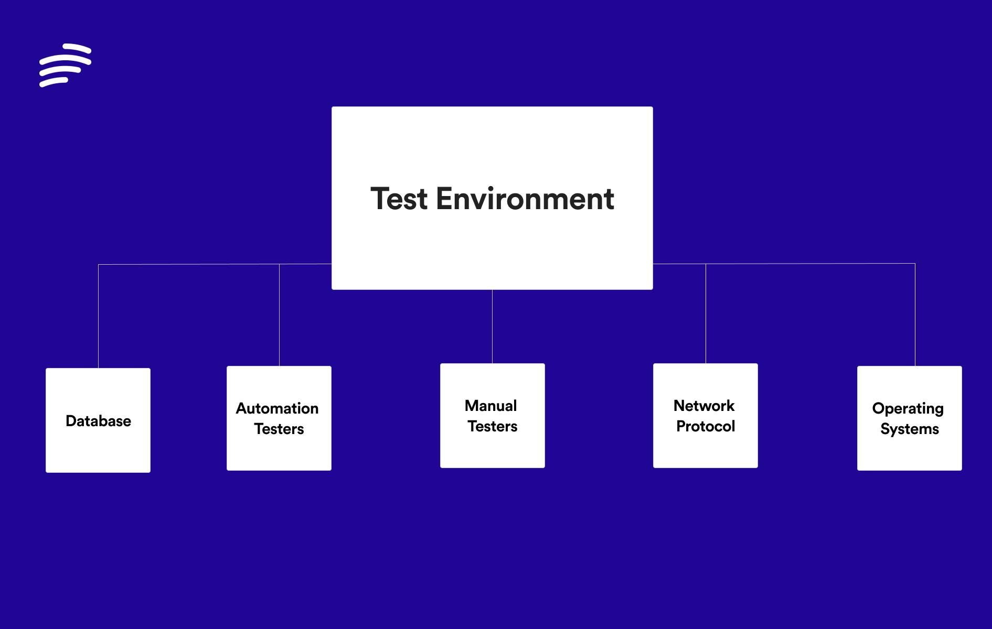
Test Environment Setup
Set up hardware and software configurations.
Prepare necessary test environments.
Verify the readiness of the test environment.

Slide 8
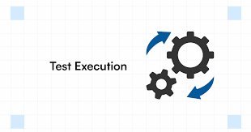
Test Execution
Execute test cases.
Logging test results.
Report defects.

Slide 9


Defect Tracking and Reporting
Logging defects.
Prioritizing and assigning defects.
Tracking defect resolution progress and reporting them.

Slide 10

Test Closure
Ensure all test deliverables are complete.
Analyze test metrics and evaluate exit criteria.
Archive test artifacts for future reference.

Slide 11


